Slide 1


Debating the Promise and Pitfalls of Clinical AI
John League and Lou Brooks
Notes:
Artificial intelligence could revolutionize health care by helping with everything from predicting the onset of clinical conditions, to improving surgeon performance, to hastening discovery of novel treatments. But there is real concern that the increasing adoption of AI could provide unequal value that exacerbates existing disparities. This workshop examined what it will take—and who is responsible—to ensure that we equitably deliver value on AI solutions that aim to improve patient care and treatment.

Slide 2











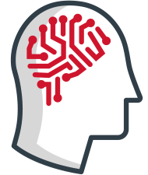

Envisioning the potential for intelligent automation
Legacy versus future primary care journey
Receptionist distributes forms
Scribe joins patient encounter
Nurse checks vitals
MA escorts patient to exam room
Patient waits for physician or APP
Clinician charts in EHR after-hours
Current state
Future state
AI automates patient registration
Algorithm determines likely diagnosis
AI performs clinical documentation
Algorithm creates follow-up care plan
AI collects patient history
AI generates evidence-based care plan
Algorithm recommends specialists
Notes:
There are many health care-related tasks that AI can transform in the future, such as the primary care journey depicted on this slide, improving the way manufacturers develop products, helping health plans manage members, or assisting researchers in drawing insights from troves of data.
Algorithms that do some of the tasks on the bottom of this slide exist today, but what makes using AI effectively so hard in health care is that we’re not just applying it to administrative or operational tasks like we do in other industries—we also must apply it to clinical tasks that impact patients’ health and lives.
The next frontier for this technology is determining how we realize value from these clinical applications of AI.

Slide 3



Value for population might not equal value for individual
AI aims to improve population health…
…but fails to account for certain patients
AI identifies patients likely to benefit from and enroll in a care management program.
AI heavily favors the individuals who it thinks will answer outreach calls, omitting certain segments of the market.
AI seems to provide value for a population…
…but doesn’t measure the program’s value for patients
AI helps providers allocate resources toward populations that need the most support.
AI doesn’t measure if the program improved outcomes for the patients it identified.
Notes:
Many AI algorithms aim to improve care, or find an optimal approach to care, for the “average” patient. By doing so, they aim to improve health for large segments of the population. But many individuals fall outside the algorithm’s definition of “average”. This highlights a key tension of AI – is it just valuable for populations, or can it be valuable for individuals as well?
For example, an organization may implement an AI algorithm that identifies patients likely to benefit from and enroll in a care management program. This technology might be helpful for some population health departments. But the algorithm favors individuals who it thinks will answer outreach calls, omitting certain individuals from these types of care management programs—sometimes the individuals who would benefit the most.
In addition, this kind of algorithm can help providers allocate resources toward populations it identifies as needing support, but it does not necessarily measure if the program itself improves patient outcomes.
Elephant-in-the-room: Bias is not baked into AI; it’s baked into society. But we can’t correct for bias until we know where it comes into play in practice.
Lightbulb: Who builds the AI is incredibly important. Organizations that understand the patient, payer, and treatment are well positioned to build the right algorithms.

Slide 4
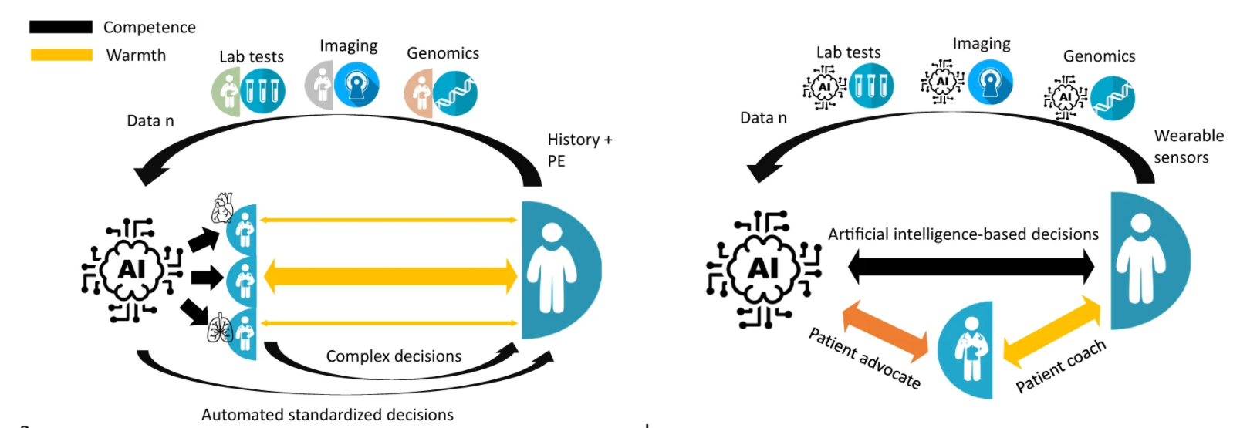
Will AI overtake a physician’s clinical competence?
Source: Drummond D, “Between Competence and Warmth: The Remaining Place of the Physician in the Era of Artificial Intelligence,” npj Digital Medicine, May 2021.
Notes:
Even if our industry can realize population and patient-level value from AI, deploying it reveals another tension – the role of the human vs. the machine in clinical decision-making.
It may be tempting to turn care decisions over to AI algorithms that are designed to make the right choices, but we then risk losing clinician adaptability, expertise, and empathy.
Imagine a future where the clinical workforce becomes so dependent on technology that they lose their core medical competencies. Considering the rapid advancements of AI in reading imaging scans, will radiologists of the future be able to perform this task without the aid of a computer? What happens if these AI systems get knocked offline due to a hacking incident or other unforeseen event?
There needs to be a balance between the tasks and roles human clinicians retain, and those that we hand over to the machine.

Slide 5
Will patients accept an autonomous AI?
Percentage of patients who would accept clinical decisions made by…
n=7,804
Source: Safavi K, Kalis B, “2020 Digital Health Consumer Survey,” Accenture, March 2020.
Notes:
Finding a balance between humans' and AI’s role in clinical care that is comfortable to clinicians does not guarantee the comfort and trust of patients.
In an Accenture survey of US adults, only 31% of respondents said they’d trust a diagnosis or treatment decision made entirely by AI, with many respondents strongly distrusting those decisions.
Clearly, stakeholders across the industry still have a cultural threshold they need to overcome to gain patients’ trust in using AI in patient care and treatment.
Elephant-in-the-room: If we’re building an algorithm based on patient derived data, our data better be good. But the first challenge to getting good data we need to tackle is ensuring patients disclose all aspects of their symptoms and conditions.

Slide 6

AI’s long-term impact unclear, even if it works as intended
Example of “successful” AI algorithm in patient diagnosis and treatment
AI algorithm uses various data inputs including basic visit information, EHR data, social determinants, genetic information, and clinician’s exam notes to determine likely patient diagnosis.
Algorithm suggests optimal therapeutic for patient based on their unique genetics and needs.
Potential ripple effects on health care industry stakeholders
Providers
Hospitals with limited financial resources see market share diminish as AI investments become a requirement for high-quality care.
Health Plans
More accurate diagnoses allow members to identify chronic disease earlier in life, increasing the amount of time they require treatment.
Life Sciences
Increased demand for precision medicine forces drug makers to run many costly clinical trials on increasingly small patient sub-sets.
Notes:
Eventually, the health care industry will overcome barriers to AI adoption and successfully navigate lingering tensions to deliver value for the entire ecosystem. But even in a world where everything works as intended, there are still ripple effects that stakeholders will need to address.
For example, imagine a world where providers commonly and successfully use precision diagnostics and treatment.
Might we find ourselves in a world of haves and have-nots? Where hospitals with limited financial resources to invest in AI see significantly worse outcomes than those that do have the resources? Might AI inadvertently become a requirement for high-quality care?
For payers, there’s certainly savings to be had from getting the patient on the right drug or therapy the first time. But if AI algorithms can diagnose certain diseases early, patients will require care for longer periods of time, potentially eating into those savings.
And for life sciences, will drug makers be running costly clinical trials on smaller and smaller sub-sets of the population?
The possibility of these ripple effects should incentivize all stakeholders to critically consider their role, and their goals for using AI to support their role, in patient care and treatment.

