Slide 1


Shaping the Future—and Value—of Precision Diagnostics
Deirdre Saulet, PhD
Notes:
Precision medicine is often touted as the future of medical treatment, but when assessing its value through a cost-effectiveness lens, most precision diagnostic tools don't seem financially viable. Does that mean they're not valuable? Or is cost-effectiveness the wrong metric here? This workshop will unpack how we apply frameworks for "value" in the context of precision diagnostics (PDx), how our understanding of "population" changes as a result, and what role industry stakeholders can play in advancing precision medicine.

Slide 2

Today’s focus
For today’s conversation: Precision diagnostics (PDx) refers to the process of using a patient’s specific biological markers (e.g., genetic code) to guide treatment decisions.
Common PDx use cases include:
Today’s focus
Risk Assessment
Screening & Detection
Diagnosis
Prognosis
Prediction
Monitoring
Identify factors to assess disease susceptibility
Indicate the presence of disease; early detection
Definitive diagnosis and general typing
Assess disease aggressiveness and likelihood of recurrence
Predict efficacy or response to treatment
Monitor disease recurrence and therapeutic response
Earlier in patient journey
Later in patient journey
Notes:
The health care ecosystem has poured time, energy, and resources into precision medicine, specifically by tailoring diagnostics and treatments to individual patients—a departure from the traditional, one-size-fits-all approach.
The definition of a precision diagnostic can be very broad. For our conversation, we focused on diagnostic technology that directly impacts treatment decision making, specifically those use cases highlighted in the dark chevrons.
This definition intentionally eliminates predictive tests that don’t inform treatments, including commercial genetic tests like 23andMe. While 23andMe can provide some health insights, it primarily offers information fitting into the risk assessment category and can be controversial and/or negatively impact a patient. We also excluded tests with murky clinical validity and/or utility that have little to no downstream effects in the patient journey, as those require a separate set of conversations.

Slide 3
What happens when a value framework doesn’t translate?
1
PDx can be cost effective for individual patients, but not necessarily for populations.
2
The industry lacks longitudinal evidence on impact of PDx, fueling skepticism.
Published literature does not show PDx significantly lowers total cost of care across a population, leading many payers and providers to not cover tests at scale.
Since the field of PDx is relatively new, stakeholders are hesitant to put testing into guidelines and to track outcomes. As a result, evidence generation relating PDx use to improved outcomes remains limited.
Notes:
There are many operational challenges hindering the implementation of PDx in clinical care, but one of the most important underlying barriers is related to the individual versus population tension: PDx is inherently designed for individuals, but the health care ecosystem tends to assess its value through a population-level, cost effectiveness lens.
While PDx can be incredibly cost-effective for a patient whose test is “positive” and therefore informs treatment, it isn’t necessarily cost-effective for an entire population.
This tension is exacerbated by a lack of longitudinal evidence demonstrating clinical utility, which furthers skepticism, limits investment, and makes it difficult to demonstrate cost-effectiveness. It becomes a chicken-and-egg problem.
It is also challenging to quantify the “quality” of a PDx test across a population. Given the limitations of currently available data and benchmarks, there is no meaningful way for clinicians or payers to evaluate the risk-benefit of using PDx and feel comfortable moving forward.

Slide 4




Cost-effectiveness approach can sometimes harm patients
 |  | Case example: Major depression
 |  | Patients who suffer from depression are often taken a through a trial-and-error approach to treatment From a provider and payer perspective, it is more cost-effective to try a series of inexpensive therapies, than it is to run PDx tests to match patients to treatments For patients, multiple treatment cycles over many months can worsen outcomes or quality of life and increase costs and risk of suicide
How should we rethink the precision diagnostics value framework?
Take a moment to write down any elephants this discussion prompts for you
“It’s awkward that we didn’t talk about… “
Notes:
Relying on cost-effectiveness frameworks for assessing value can not only disincentivize investment in PDx, but it can also harm patients. Many PDx tests are expensive, while associated treatments can be inexpensive. Adopting a cost-effectiveness approach to value can lead to the conclusion that trial-and-error is sometimes the more “valuable” way treatment path.
Depression treatments are a prime example: it is far more cost-effective to try a series of inexpensive treatments rather than using an expensive PDx test to match patients to treatments. The trial-and-error approach aligns with a cost-effectiveness framework but puts patients through multiple treatment cycles, which can worsen outcomes because each new cycle increases the risk of suicide.
Lightbulb: The cost of expensive PDx tests will likely go down over time, which could make trial-and-error seem less appropriate over time compared to PDx-driven treatment matching.
Elephant-in-the-room: There are certain cases where we’ve tacitly decided it is okay to wait for a test to become economically viable before adopting it widely—even if that means patients die.

Slide 5
If cost effectiveness isn’t the right framework, what is?
A highly valuable PDx tool will…
Identify targeted treatment for patients
Reduce TCOC for individual patient
Reduce TCOC for population
Improve efficiency of care
Increase confidence of diagnosis
Improve health equity
Generate certainty and “value of knowing” for patients
Reduce trial-and-error of treatment
Generate representative data to improve future diagnosis
Other?
Using Mentimeter, allocate 100 pennies across the value drivers above.
Notes:
When evaluating PDx, stakeholders typically focus on drivers such as clinical utility and cost. However, PDx can create value in many other ways, including the drivers listed on the slide.
We know cost-effectiveness should not be the only thing that dictates value, so we need to determine what other drivers should be considered.
Many of these drivers are interrelated and have different definitions depending on your vantage point. When having conversations with other stakeholders, it is important to define these terms and air out assumptions.
During this time, participants were asked how they would allocate 100 pennies across the above value drivers, and what could fit into “other.” The results are on the next page.

Slide 6
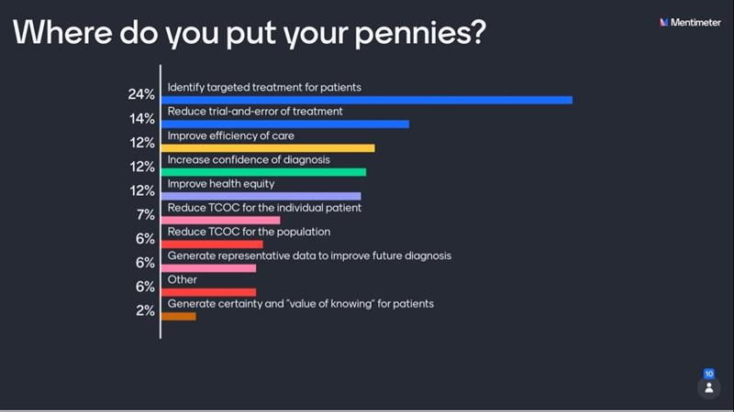
Notes:
Shown above are the live poll results from the session. Drivers in “other” included: must be actionable, must mitigate additional anxiety of patient, and minimize waste potential.
Participants’ discussion comments included:
Tests should be linked to targeted treatments to directly improve outcomes, especially to reduce trial-and-error treatment.
Discussions around validity and usefulness should be separate from the cost of a test. However, targeted treatments, led by good tests, lead to better total cost of care both for an individual and a population.
Cost has a direct impact on access and health equity, which further complicates how we evaluate the value of a PDx test.
Generating certainty and “value of knowing” for patients was a complicated driver due to low levels of health literacy, especially around the kinds of conditions and mechanisms of disease that tend to be associated with PDx technology.

